Slide 1
Understanding the Drivers of Obesity Trends in the U.S.
Analyzing Demographic and Temporal Factors
By: Vineet Mehta

Slide 2
INTRODUCTION
obesity is a growing public health issue in the U.S., leading to health complications and increasing healthcare costs.
Project Objectives:
Explore the trends in obesity, overweight, and normal weight categories over time.
Understand how demographic factors (age, gender, ethnicity) influence weight categories.
Analyze key drivers of changes in weight categories.

Slide 3
Datasets Used
• Primary Data Sources:
Dataset 1: Normal weight, overweight, and obesity among adults aged 20 and over by selected characteristics.
Dataset 2: Nutrition, Physical Activity, and Obesity - Behavioral Risk Factor Surveillance System.
Key Variables in Dataset 1:
INDICATOR: Weight category (Normal, Overweight, Obesity)
PANEL: Demographic groups
YEAR: Time period of data
ESTIMATE: Prevalence of weight category
Key Variables in Dataset 2:
Behavioral risk factors (e.g., nutrition, physical activity)

Slide 4
Analysis Methods
Descriptive Analysis: To understand trends in weight categories.
Predictive Modeling: Logistic regression and classification models to analyze the likelihood of obesity based on demographic factors.
Visualization: Using graphs to show trends and relationships in data.

Slide 5
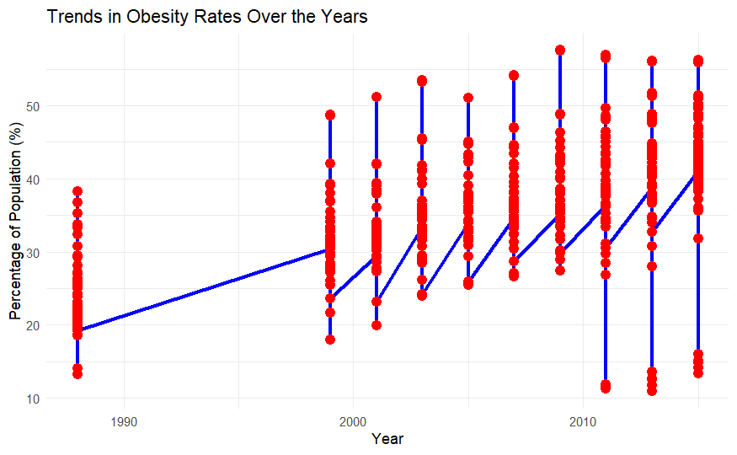
Trends in Obesity Among U.S. Adults Over Time
The graph below shows the trends in obesity rates over the years based on available data.

Slide 6
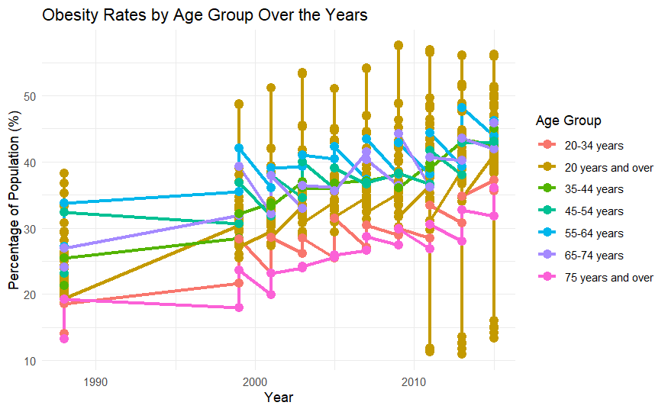
Influence of Demographic Factors on Obesity
Age: Older adults tend to have higher obesity rates.

Slide 7

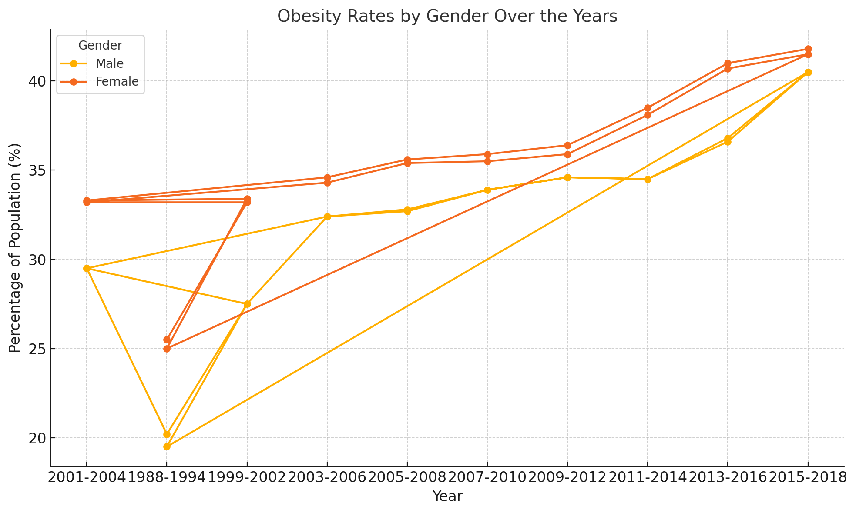
Gender:Men and women may have different rates of obesity based on behavioral and biological factors.

Slide 8
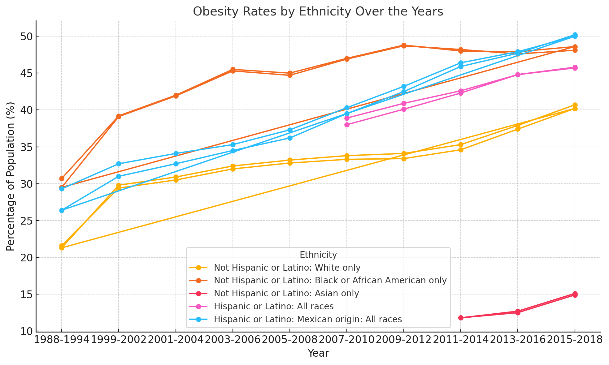
Ethnicity:
Some ethnic groups are disproportionately affected by obesity.

Slide 9
Conclusion
Rising Obesity Rates Over Time:
Obesity rates among U.S. adults have consistently increased over the past decades, indicating a growing public health concern.
Demographic Factors Matter:
Age: Older adults have higher obesity rates compared to younger adults. This trend is consistent over time.
Gender: Obesity rates differ between men and women, with one gender (based on your data) showing a higher prevalence in certain years.
Ethnicity: Certain ethnic groups show a disproportionately higher obesity rate, suggesting that cultural, socio-economic, and access-to-resources factors play a role.
Behavioral Risk Factors:
Data from the Behavioral Risk Factor Surveillance System shows that lifestyle factors such as diet and physical activity are key drivers of obesity. Regions or populations with less physical activity and poor nutrition habits have higher obesity rates.

Slide 10
Policy Implications:
Targeted Interventions:
Public health programs should focus on high-risk groups, such as older adults and certain ethnicities, by promoting healthier lifestyles, improving access to nutritious food, and encouraging physical activity.
Health Education:
Educational campaigns tailored to different demographics can raise awareness about the dangers of obesity and offer solutions for reducing risk factors.

Slide 11
Future Research Directions:
Deeper Analysis of Behavioral Factors:
A more detailed exploration of how specific behaviors (diet, exercise, etc.) contribute to changes in weight categories across different demographics could yield actionable insights.
Longitudinal Studies:
Tracking individuals over time can help identify causal relationships between lifestyle changes and obesity, further aiding in prevention strategies.

Slide 12
Final Thought
Obesity is not just a personal health issue—it’s a widespread societal challenge with implications that span public health, economic productivity, and healthcare systems. The consistent rise in obesity rates across all demographic groups, particularly among older adults and specific ethnic communities, suggests that the current approaches to prevention and intervention are insufficient. These trends highlight the urgent need for targeted, data-driven public health initiatives.
Why This Matters
Addressing Health Disparities
The Role of Individuals and Communities
Looking Forward

Slide 13

Thank You

